Slide 2
Und wie so teuer die Energie, und wie so rar das Geld!
( Frei nach Heinrich Heine, Buch der Lieder (1827)

Slide 3
Propsal of the Czech ministry of finance to raise from 2014
the tax for
coal
from the present 292 Kč/t to 2574Kč/t
Heavy heating oil
From the present 472 Kč/t to 2843 Kč/t
Lihght heating oil
From the present 660 Kč/t to 2779 Kč/t

Slide 4
Until approximately 1990-91
in Czechoslovakia existed
At that time it was plenty of cheap energy.
When energy started to be expensive and
its supplies more problematic,
the Czech politicians structured over the
Government and Energy is today only one
Department in the Ministry of Industry and Trade(!).
Ministry of Fuels and Energy (Ministerstvo Paliv a Energetiky)

Slide 5
4 years
versus
40 years

Slide 6
Decisions about energy policy are a very difficult task. I usually illustrate this with two figures
4 years versus 40 years
4 years is time for which a politician is in most countries elected to the parliament, 40 years is a reasonable time horizon for planning our energy vision or strategy.

Slide 7
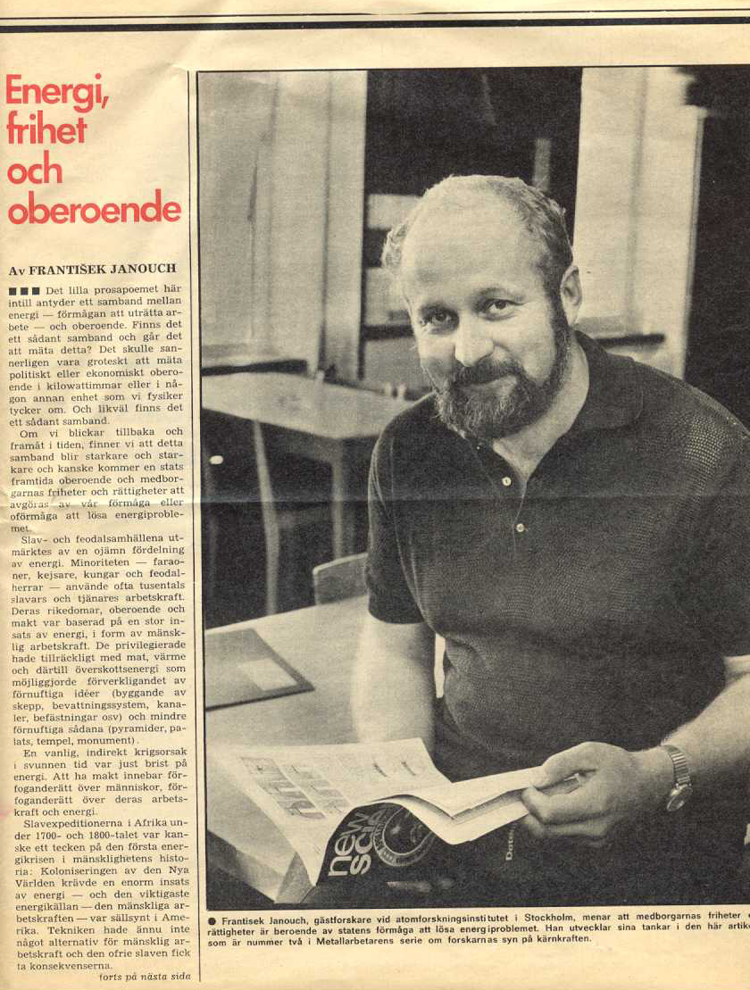
June 1975
ENERGY, FREEDOM AND INDEPENDENCE

Slide 8
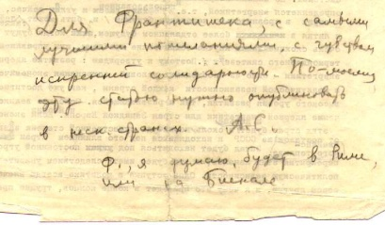
To save paper Andrey Sakharov wrote greetings and instructions at the last page of his article.

Slide 9
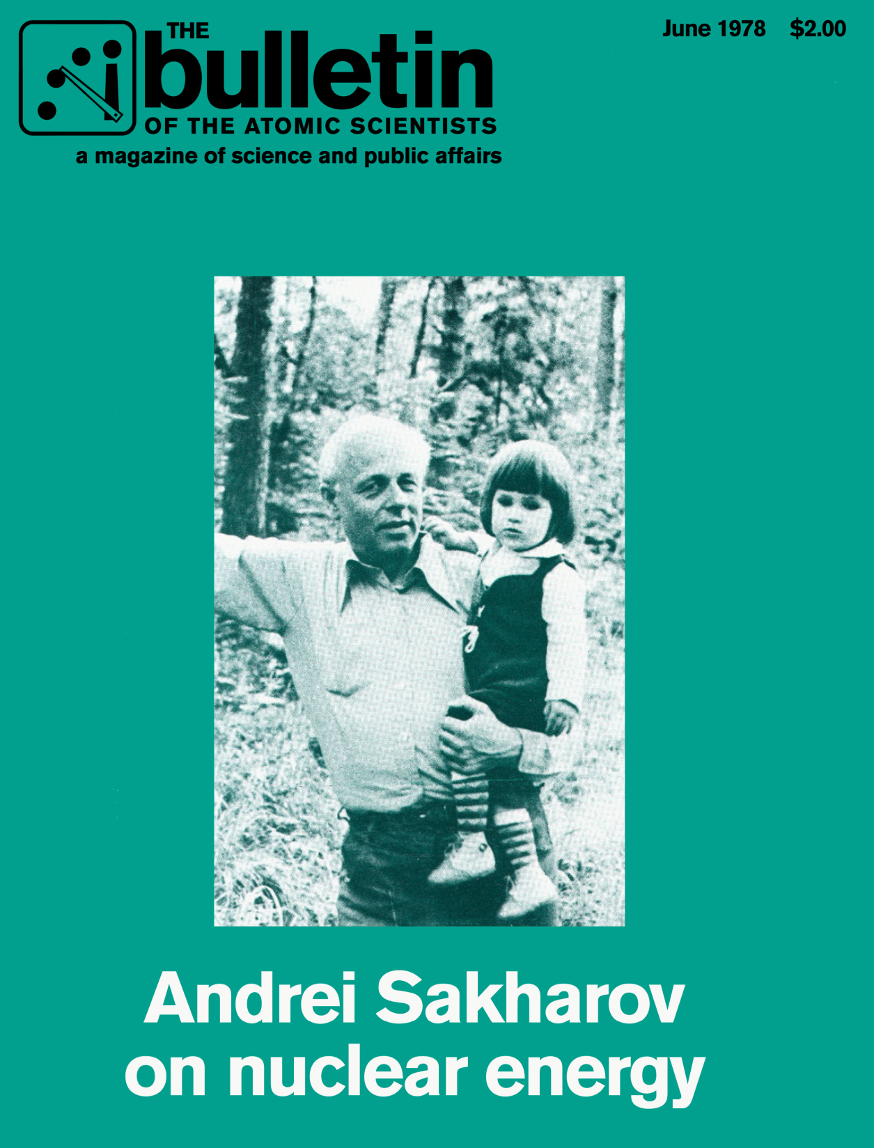
1978
Nuclear Energy and
The Freedom of the West

Slide 10
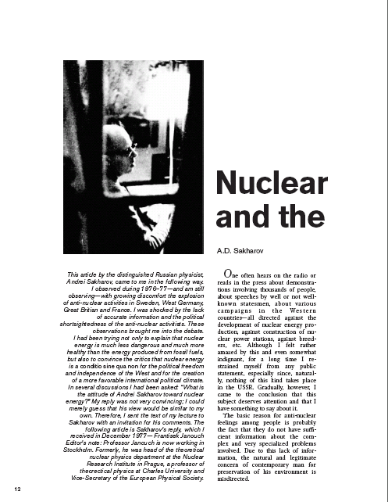
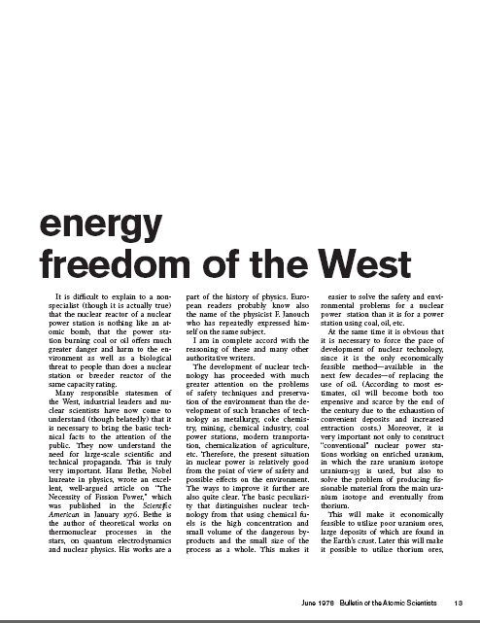
For Sakharov it was clear already in 1978 that the nuclear energy and
The Freedom of the West are interrelated. When this simple truth will be finally accepted by the EU?

Slide 11
A quarter of century later….

Slide 12
Mr. Donald J. Johnston,
Secretary General of OECD,
Pamplona, Spain in April 2002:
 It will require policy leadership to bring energy
to the top of the policy agenda and to keep it there…
 It will require vision to anticipate problems well
ahead of time so that they can be addressed in
an orderly manner…
 It will require political courage to make difficult
choices, notably for the trade-offs between the
welfare of the present versus future generations.

Slide 13
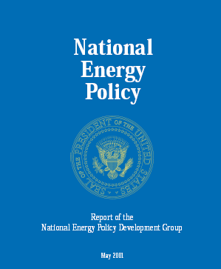

Slide 14

Spolehlivá, dostupná a zdravá
z hlediska životního prostředí
energie pro budoucnost
Ameriky

Slide 15
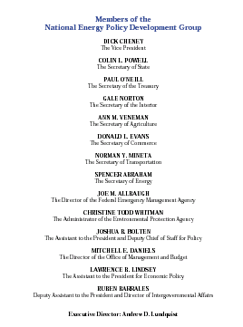

Slide 16
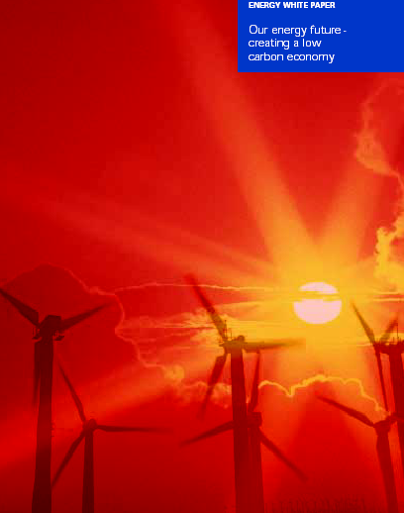
Bílá kniha o energii
Naše energetická budoucnost – vytvoření nízko uhlíkatého hospodářství
ENERGY WHITE PAPER
OUR ENERGY FUTURE
CREATING A LOW
CARBON ECONOMY
2003

Slide 17
In his 2003 foreword Tony Blair believed that UK can achieve its goals (60% reduction of Carbon emissions) until 2050.
In the foreword to the second version White Paper on Energy in 2007 Blair admitted that it would be impossible to achieve this goal without using and developping nuclear energy.

Slide 18
Even EU
came with its Energy visions…

Slide 19
It is necessary to introduce elementary courses about energy to the primary and secondary schools!
(… and introduce even energy „qualification“ courses for adults and especially for politicians!)
Many new courses or disciplines are presently introduced: Hygiene, sexual education including anticonception, human rights etc. Why not ENERGY PRIMER -s?

Slide 20
ENERGY PRIMER
A HANDBOOK FOR POLITICIANS,
MY GREEN FRIENDS
AND FOR
US, CITIZENS OF THE PLANET EARTH

Slide 22
ORIGINE OF OUR ENERGY SOURCES
Solar Energy Synthesis of Light Nuclei
Geothermal Energy Radioactive Decay
Wind Energy Sun
Hydro Energy Sun
Wave Energy Wind →Sun
Fossils Stored Solar Energy
Biomass Photosynthesis → Sun
Tidal Energy Gravitation, Big Bang

Slide 32
The more energy you have at your disposal, the more and the faster you can perform different activities.
Possessing only one „horse power“ a trip from
Paris to Stockholm took a week or two. Using a modern jet (and using tens of thousands of horse-powers) you cover the same distance by two hours.
Cultivating one acre by hands would take several days. By using a horse you can do it in several hours. A tractor (hundreds of horse powers) will shorten the necessary time to a fraction of a hour!

Slide 33
The Ten Energy Commandments
5. Until now we have not succeeded to stop the population explosion. The population of our Planet is increasing daily by about
200.000 people

Slide 34
206.000 -
NET WORLDPOPULATION INCREASE PER DAY
IN JANUARY 2012

Slide 35
Saturday, Feb. 3, 2012:
World population 7 020 000 000 (Friday, Feb. 3)
Net population would increase in 2012 by
75.000.000 people
Net daily increase: 206 000 /day
Visit eg
http://www.worldometers.info/

Slide 37
To cover the increased need for electricity on the world average level (installed is about 2.5 kW/person).
2.5x 200.000= 500.000 kW/per day (500 MW).
Which means, that in order not to deteriorate the energy „inbalance“ (or shortage) we need globally every second day
to install
one Temelín reactor!

Slide 39
86.1%
79.3%

Slide 44
SEVEN LARGEST ENERGY SINS?
SEDM NEJVĚTŠÍCH
ENERGETICKÝCH HŘÍCHŮ?

Slide 45
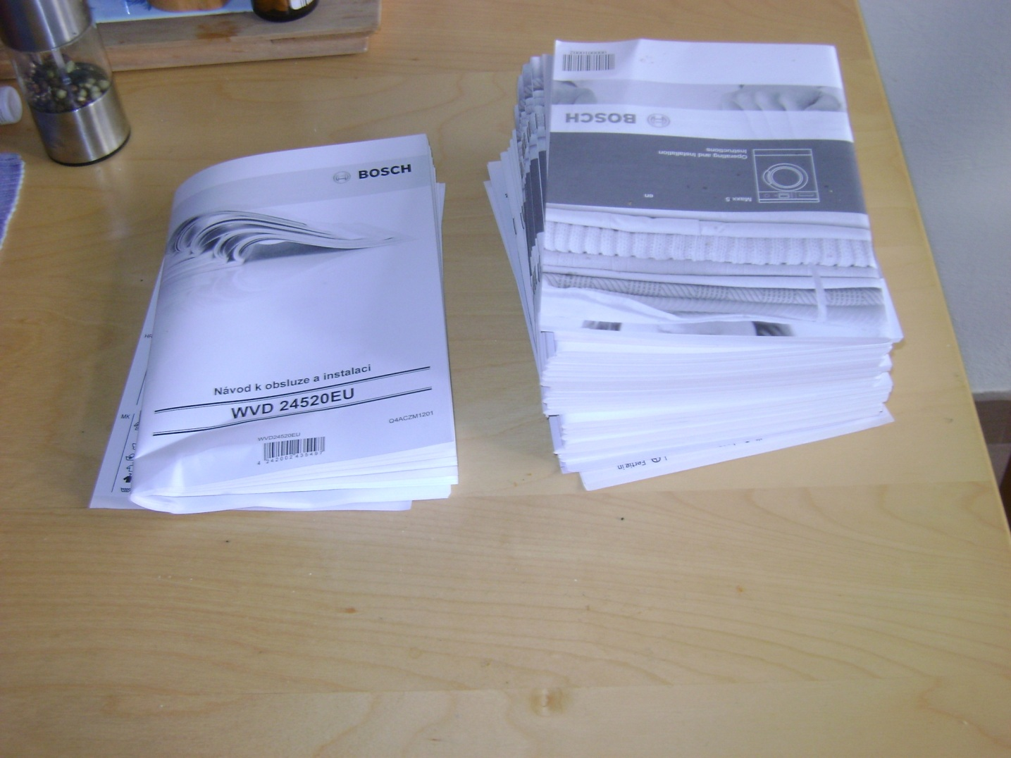

Slide 46
Renewables
Be carefull with prognoses!

Slide 49
Sweden‘s direct zick-zack road
to a radiant, problemless,
ENERGY future:

Slide 50
Sweden
Sixties, seventies developing and building 12 nuclear reactors
and by now ready and accepted system
for deposition of nuclear waste.
Sweden NPP produces app 45% of electricity
Seventies, eighties Referendum (1978), Decision od the Swedish Riksdag (1982) to phase out NP by 2010
2000 (around) Closing down to smallest and oldest NPP
Barsebäck I and II
2001 (starting Power (effect) of the remaining 10 NPP was
gradually increased to replace the Barsebäck
electricity production
Sweden is using the same 45% of nuclear as by the beginning of 80-ies. Swedish Riksdag changed the law: NPP are allowed to be operated indefinitely and new ones are allowed
to bu built!

Slide 51
European Union -27
16 Countries are or were using Nuclear Energy:
Belgium, Bulgaria, Czech Republic, Finland, France, Germany, Lithuania, Hungary, The Netherlands, Rumania, Slovakia, Slovenia, Spain, Great Britain, Sweden and Switzerland (not EU)
3 Countries are planning to phase out nuclear energy: Belgium, Germany, Spain
4 (5) States are planing to build new NPP
Estonia, Latvia, Poland, Italy, Turkey (not yet EU)

Slide 52
EU-27 IS A NUCLEAR POWER
52
EU-27 is the largest „nuclear power“ in peaceful use of nuclear energy
EU-27 produces some 8% more nuclear electricity than North America, 3 times more than Japan and almost 7 times more than Russia
Only 4 states in the world cover its electricity consumption by more than 50% by NPP – all four belongs to EU-27.
Notes:
52

Slide 53
Nuclear Power in EU-27
Provides 35% of electricity consumption
Posseses a high level of safety
Is the cheapest way of electricity production
Investments are already mostly amorted
Nuclear energy has a very stable structure of costs
NPP plant can be (and are!) modernized at very reasonable costs
Contributes to creation of highly specialized and highly qualified centra (high-technology centres)
Eliminates energy import risks (energy security)
53

Slide 54
CZECH REPUBLIC

Slide 55
ELECTRICITY PRODUCTION
Czech Republic Austria
fossils 76.1% 29.3%
hydro 2.9% 67.2%
nuclear 20% -----

Slide 56
CZECH REPUBLIC ELECTRICITY PRODUCTION GAP
PRODUCTION VERSUS CONSUMPTION
123-146 TWh
DOMESTIC CONSUMPTION
101-110 TWh
Missing production capacities
87-110 TWh
59-68 TWh
EXISTING COAL POWER PLANTS
GAS AND RENEWABLES
NUCLEAR POWER
HYDRO
Notes:
Pokud nyní porovnáme vývoj spotřeby elektrické energie až do roku 2030 s dostupnými zdroji, zjistíme, že již po roce 2010 nebudou stávající výrobní kapacity schopny pokrýt tuto rostoucí poptávku. To je způsobeno zejména velmi rychlým dožíváním současných uhelných elektráren.
V roce 2020 bude chybějící objem dosahovat již 59TWh, v roce 2030 pak zhruba 100TWh.
Proto pokud chceme tento problém řešit, je nutné již nyní rozhodnout o obnově zdrojů v České republice.

Slide 57




CZECH REPUBLIC CAN‘ T RELY ON
ELECTRICITY IMPORTS
2
  Political decision to close all NPP (providing 27% of electricity consumption)
  own electricity consumption will be hardly covered by own resources
  Poland will close 3500 MW of coal power plants due to environmental reasons to the year 2015. Possible closure up to 7000 MW of coal PP.
  Already closing of 3500 MW will make Poland dependent of electricity imports.
  Presently no PP constructed, perspective plans for PP construction exist
  Impossible to rely on import of electricity from neighboring countries
  In central Europe will be to 2030 closed about 30 GW of power plants
  It is expected a shortage of about 15 GW of electricity producing capacities
Poland
Germany
Czech Republic
Slovakia
Austria
  2008 two NPP units closed (1600 MW(e).
  From a pure exporter of electricity country is becoming a pure importer
Hungary
  In peaks depends on imports
  Total electricity import 2005 16.3 TWh (Production of both Temelin units)
  Largestelectricity importer in Central Europe (18%)
  No plans for construction of PP
  Limited fuel reserves
* Nováky, Vojany, Jaslovské Bohunice
Notes:
Bude možné nedostatek elektrické energie v ČR v roce 2020 pokrýt dovozem z okolních zemí? Podívejme se na jejich energetickou situaci. Maďarsko je již dnes největším dovozcem ve střední Evropě – dováží 18% své spotřeby. Je velmi limitováno omezenými palivovými zdroji a navíc neexistuje ucelená koncepce plánů výstavby. Podobně jako Maďarsko i Rakousko je již dnes ve špičkách závislé na dovozu. Polsko a Slovensko jsou sice v současné době čistými vývozci elektrické energie, jejich výrobní kapacity se ovšem v budoucnu dramaticky sníží – v Polsku dojde k uzavření 3500 MW instalované kapacity z ekologických důvodů (toto číslo se může zvýšit až na 7000 MW), na Slovensku bude uzavřeno téměř 1600 MW instalované kapacity. Energetická situace Německa bude zásadním způsobem ovlivněna politickým rozhodnutím uzavřít veškeré jaderné elektrárny do roku 2020. Pokud bude toto politické rozhodnutí realizováno, pokryje Německo, i přes značný investiční boom do energetiky, maximálně svoji spotřebu elektrické energie.

Slide 58
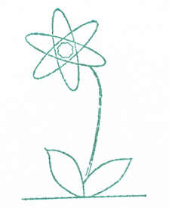
THE END
THANK YOU
FOR YOUR ATTENTION!

